Slide 1
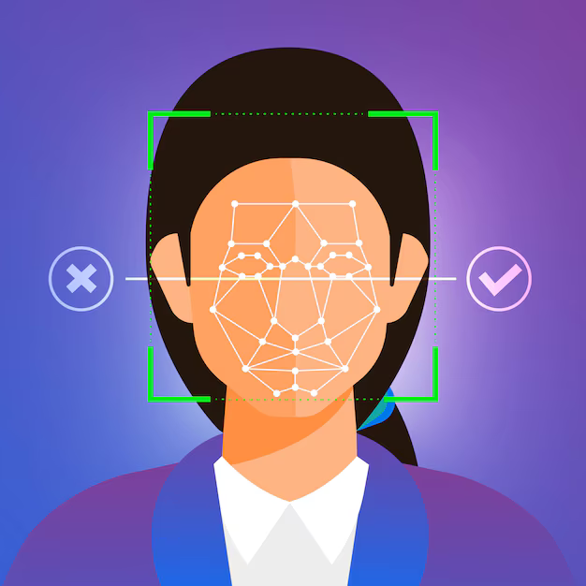

Missing Person
Detection Webapp
using Deep Learning.

Slide 2
System Design.
Implementation.
References.
Table of
Contents

Slide 3
System Design.
The system has 2 parts: The front-end and the backend.
The Front-end comprises of the modules such as login, signup, user registration, missing person upload, and other UI/UX part for the use to interact with the system.
Front-end has been developed completely in HTML and CSS.
HTML is used for layouts, designs, buttons, pages, etc and CSS used for styling.
HTML functions like button, input, url_for, etc are used for data upload and page navigation.

Slide 4
System Design.
The Front-end has multiple pages such as the landing page, home page, login and signup pages, signup success and login fail pages, profile page for the user, etc.

Slide 5
System Design.
The Backend has the face recognition engine based on the FaceNet model. The backend also has modules like face extraction and preprocessing, embedding generation, matching, alert system, and Sqlite database storage.
The backend has been developed completely in Python.
Python libraries are used.
SQLite database used to store user details and data locally.
Flask API is used to connect between pages and backend.

Slide 6
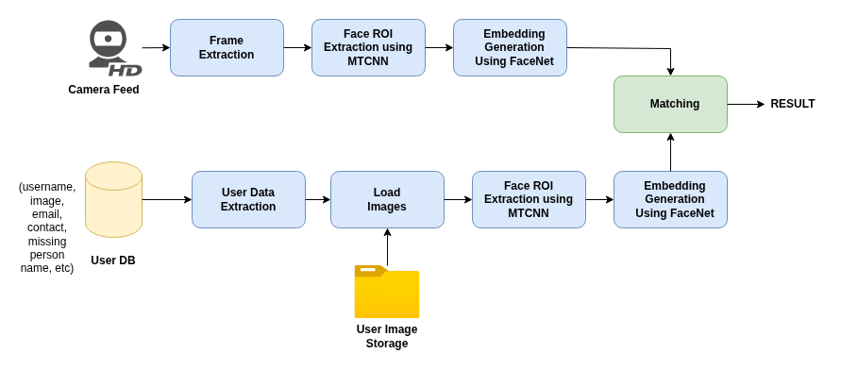
Architecture
The Face Recognition Pipeline

Slide 7
Architecture
The user data is saved in the SqLite DB.
The DB has the path and filenames of the images user uploaded.
This images are loaded, the faces are extracted using the MTCNN (Multi-task Cascaded Convolutional Networks) model.
Embeddings for these faces are generated using the FaceNet model and saved as a list of embeddings.
Then the real-time feed is taken from the webcam, the frames/images are extraected, faces are extracted using MTCNN, embedding is generated for the face in the camera using FaceNet.
This embedding is compared with all the embeddings in the list and teh best match is taken as the output of the face recognition pipeline.

Slide 8
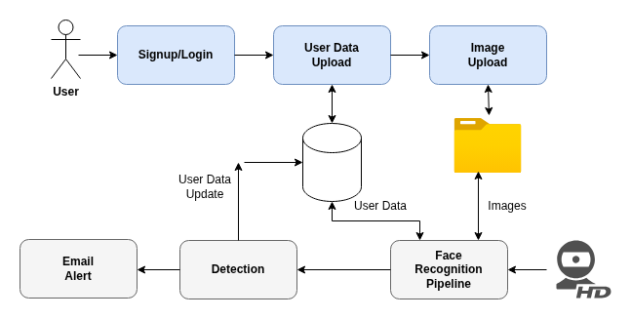
Architecture
Basic System Architecture

Slide 9
Methodology
User Signup and Login modules are added.
The user details are stored in the SQlite DB locally.
DB Details:
The user table stores the below details.
username, email, contact, address, missing person name, relationship with missing person, missing since, upload time, missing person image, path to missing person image, current status, and password.
Once detected, the frame is saved and the current status is updated in the DB. Email alert is also sent.

Slide 10
Methodology
Python Libraries used:
common libraries like numpy, os
Flask for API
OpenCV for dealing with images, videos, etc.
sqlite3 for DB
Kersa, Tensorflow for deep learning
MTCNN
smtplib, email for sending email

Slide 11

Implementation.

Slide 12
Implementation
Screenshots
landing page, login, signup page, user profile, photo upload, detection result, email alert, etc.

Slide 13
References.

Slide 14
Thank you!

